Slide 1

R for Bioinformatics Introduction
Maria-Theodora Pandi
PhD Candidate, Erasmus MC Rotterdam

Slide 2



about::me
PhD Candidate in Bioinformatics, Department of Pathology, Erasmus Medical Center
MSc in Informatics for Life Sciences, Bioinformatics Discipline, UoP
Pharmacy Bachelor Degree, UoP
@mtpandi17
@mtpandi
(Pharmaco)genomics, Bioinformatics, Machine Learning, Health Economics, Text Mining, Biostatistics, Visualization
R / Python

Slide 3
Research lab good data analysis practices
Work towards answering a well-defined question
Have a detailed, structured plan in mind
Always keep a copy of the original data
Respect your data – they are precious
Know your data
How were they produced?
By whom?
Question the quality of your data
Exploratory data analysis -> does anything seem off?
If you’re not sure, ask someone
Present intermediate results in a meaningful way
Keep it simple
Reproducible research
https://journals.plos.org/ploscompbiol/article?id=10.1371/journal.pcbi.1004961

Slide 4
Data preprocessing
Small n large p problem:
https://royalsocietypublishing.org/doi/10.1098/rsta.2009.0159
Cleaning
Missing data
Noise
Inconsistencies
Integration
Transformation
Normalization
Aggregation
Generalization
Feature construction
Reduction

Slide 5
Part IIa
Data Manipulation

Slide 6
Table of contents
Iris dataset
Data frames
Data processing
Basic plotting in R – Histograms & Density plots
Basic plotting in R – Bar plots
Basic plotting in R – Pie charts
Basic plotting in R – Boxplots
Basic plotting in R – Scatter plot
Basic plotting in R – plot() options
Graphical parameters
Customizing a graph
Multiple plots
Saving plots
Resources used

Slide 7

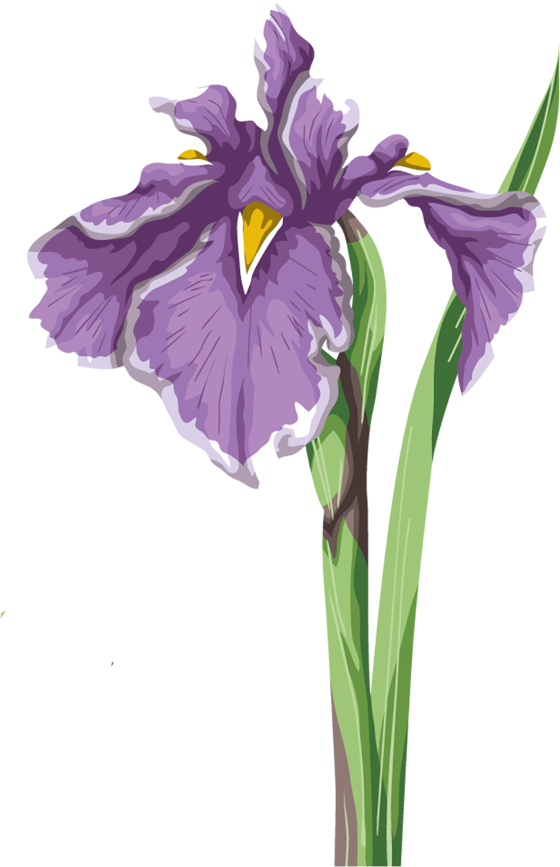
Iris Plants Database
Data set created by Fisher (Fisher,R.A. "The use of multiple measurements in taxonomic problems" Annual Eugenics, 7, Part II, 179-188 (1936)) in 1988
Perhaps the best-known database to be found in the pattern recognition literature
Contains 3 classes of 50 instances each, where each class refers to a type of iris plant.
sepal length in cm
sepal width in cm
petal length in cm
petal width in cm
class (Iris Setosa, Iris Versicolour, Iris Virginica)
https://archive.ics.uci.edu/ml/datasets/iris
Built-in in R (just type iris)

Slide 8
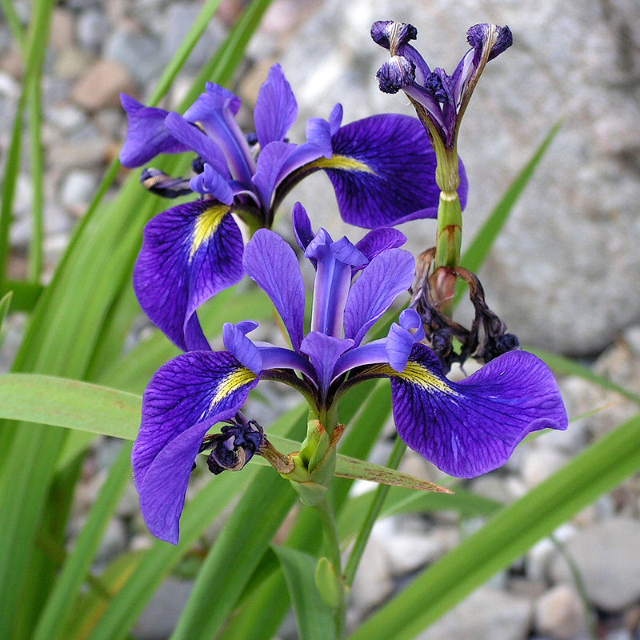
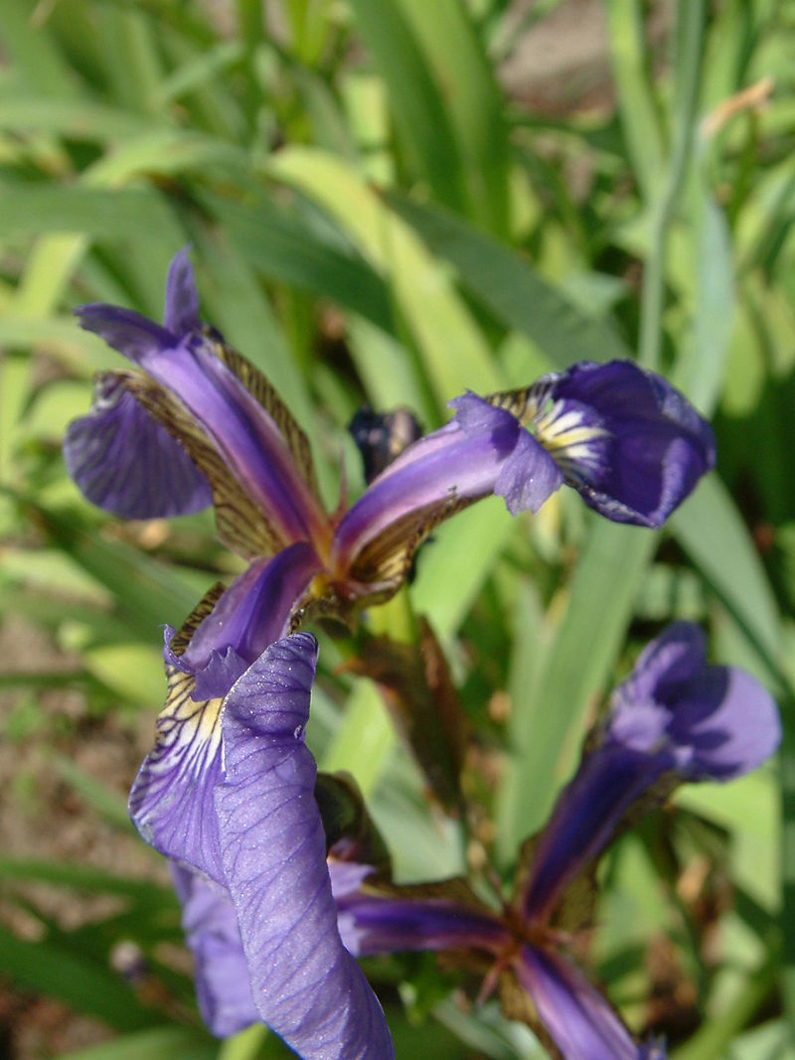
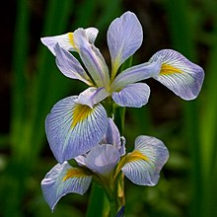
Iris
Iris versicolor
Iris setosa
Iris virginica

Slide 9
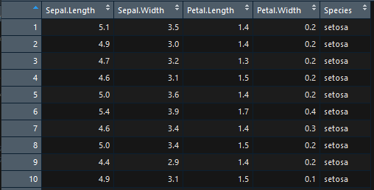
Data frames
A convenient was to store and present data
Each column is a variable
Each row is an observation (a collection of values for each variable)

Slide 10
Data processing
Preprocessing and exploratory analysis (baseR and dplyr)
Overall summary statistics and structure
Rename columns
Add and remove columns
Add and remove rows
Subset/filter rows
Select columns
Applying functions to data frames
Missing values

Slide 11
PartIIb
Basics of data visualization in R

Slide 12
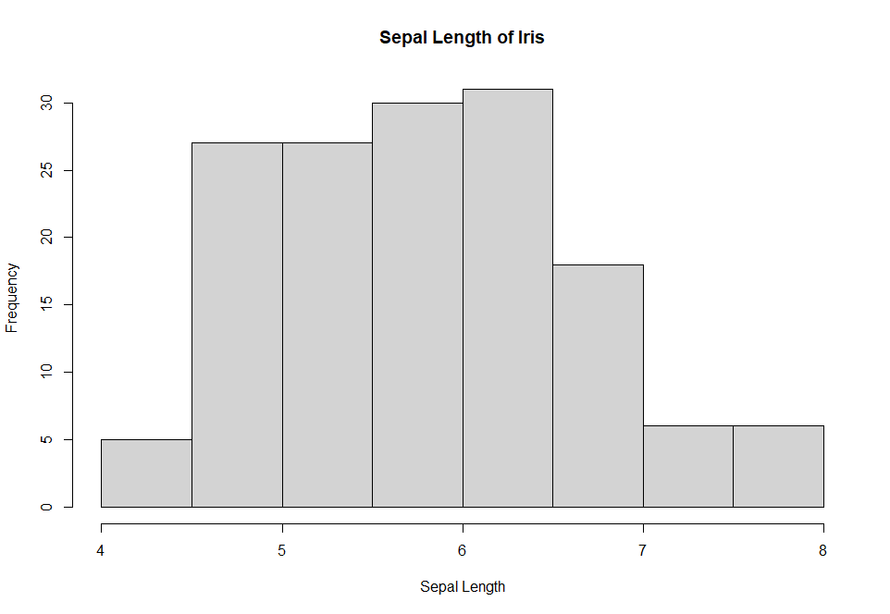
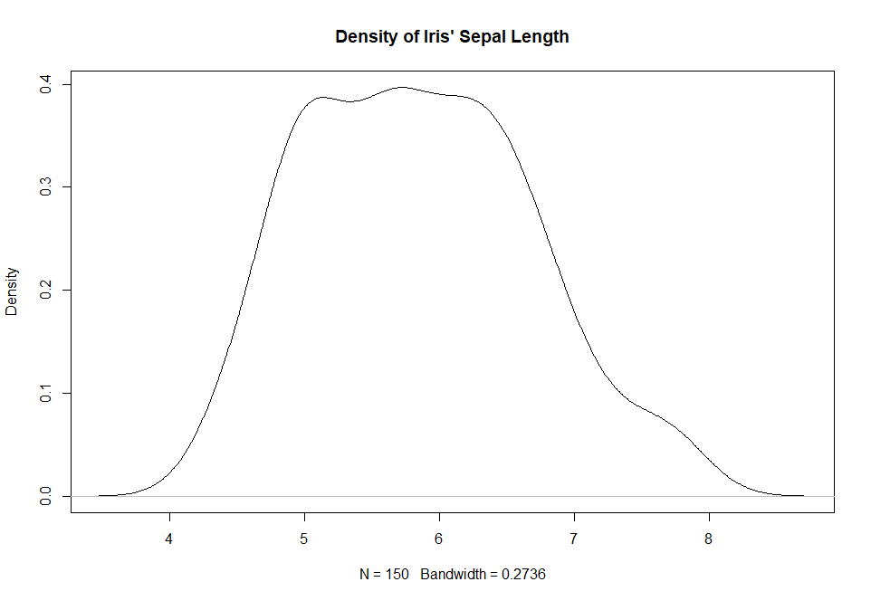
Basic plotting in R – Histograms & Density plots
Histogram: an approximate representation of the distribution of numerical data
hist(x, freq = T/F, …)
Parameters:
freq: logical, when TRUE we get the count, when FALSE we get the percentage
main, xlab, ylab: characters with the names of the main title, x axis and y axis
xlim, ylim: the range of x and y axes
labels: logical (T/F) or character
axes : logical (T/F)
Density plot: Variation of histograms – shows the distribution of numeric variables
plot(density(x))

Slide 13
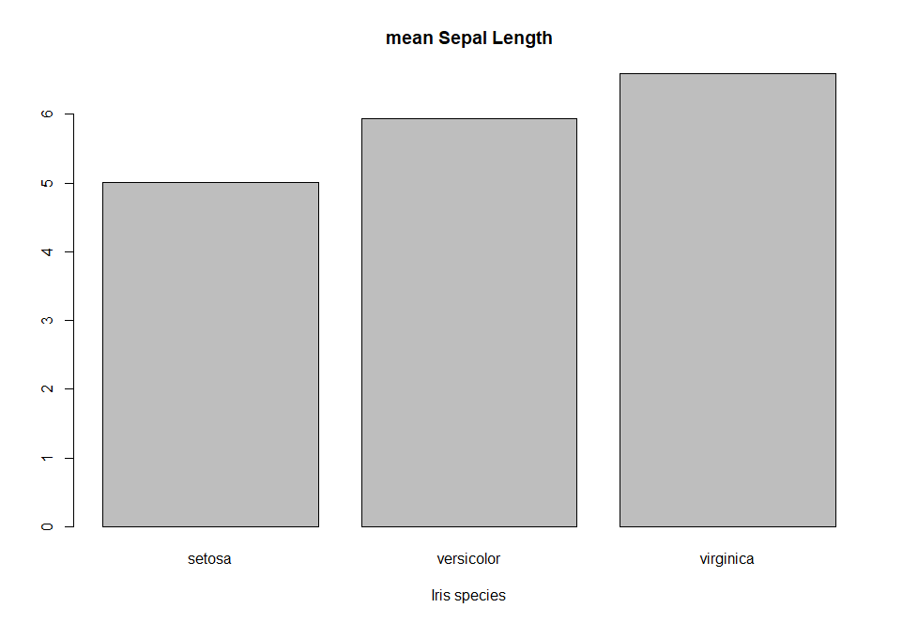
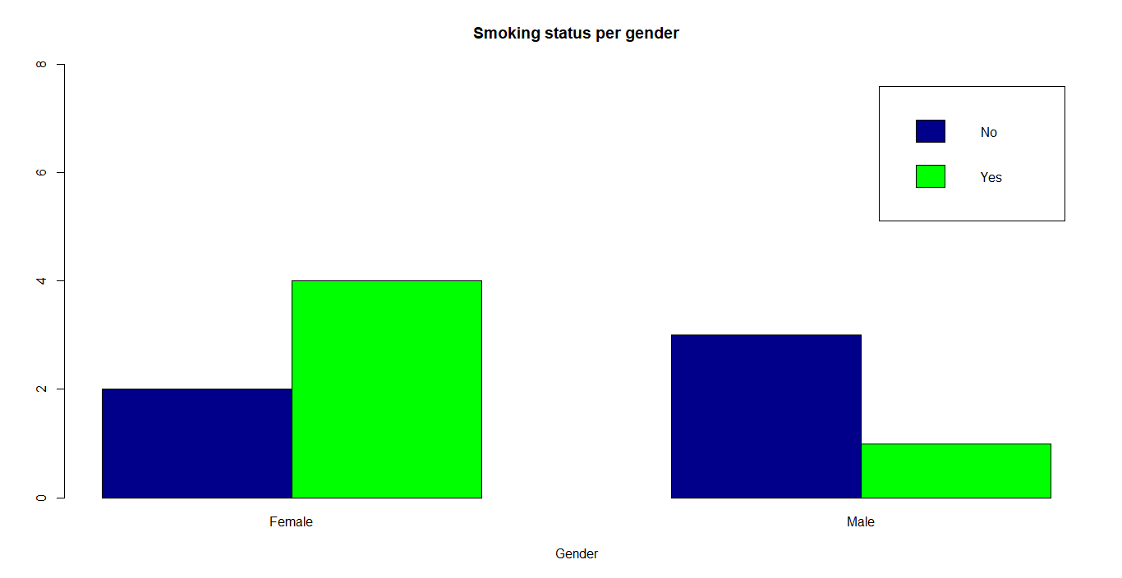
Basic plotting in R – Bar plots
Useful for categorical data: one axis shows the specific categories being compared, and the other represents a measured value
barplot(data, xlim, ylim, xlab, ylab, main, legend, beside = T/F, horiz=T/F)

Slide 14

Basic plotting in R – Pie charts
Seriously though, avoid pie charts
pie(x, …)
Pie charts are a very bad way of displaying information. The eye is good at judging linear measures and bad at judging relative areas. A bar chart or dot chart is a preferable way of displaying this type of data.
Cleveland (1985), page 264: “Data that can be shown by pie charts always can be shown by a dot chart. This means that judgements of position along a common scale can be made instead of the less accurate angle judgements.” This statement is based on the empirical investigations of Cleveland and McGill as well as investigations by perceptual psychologists.

Slide 15
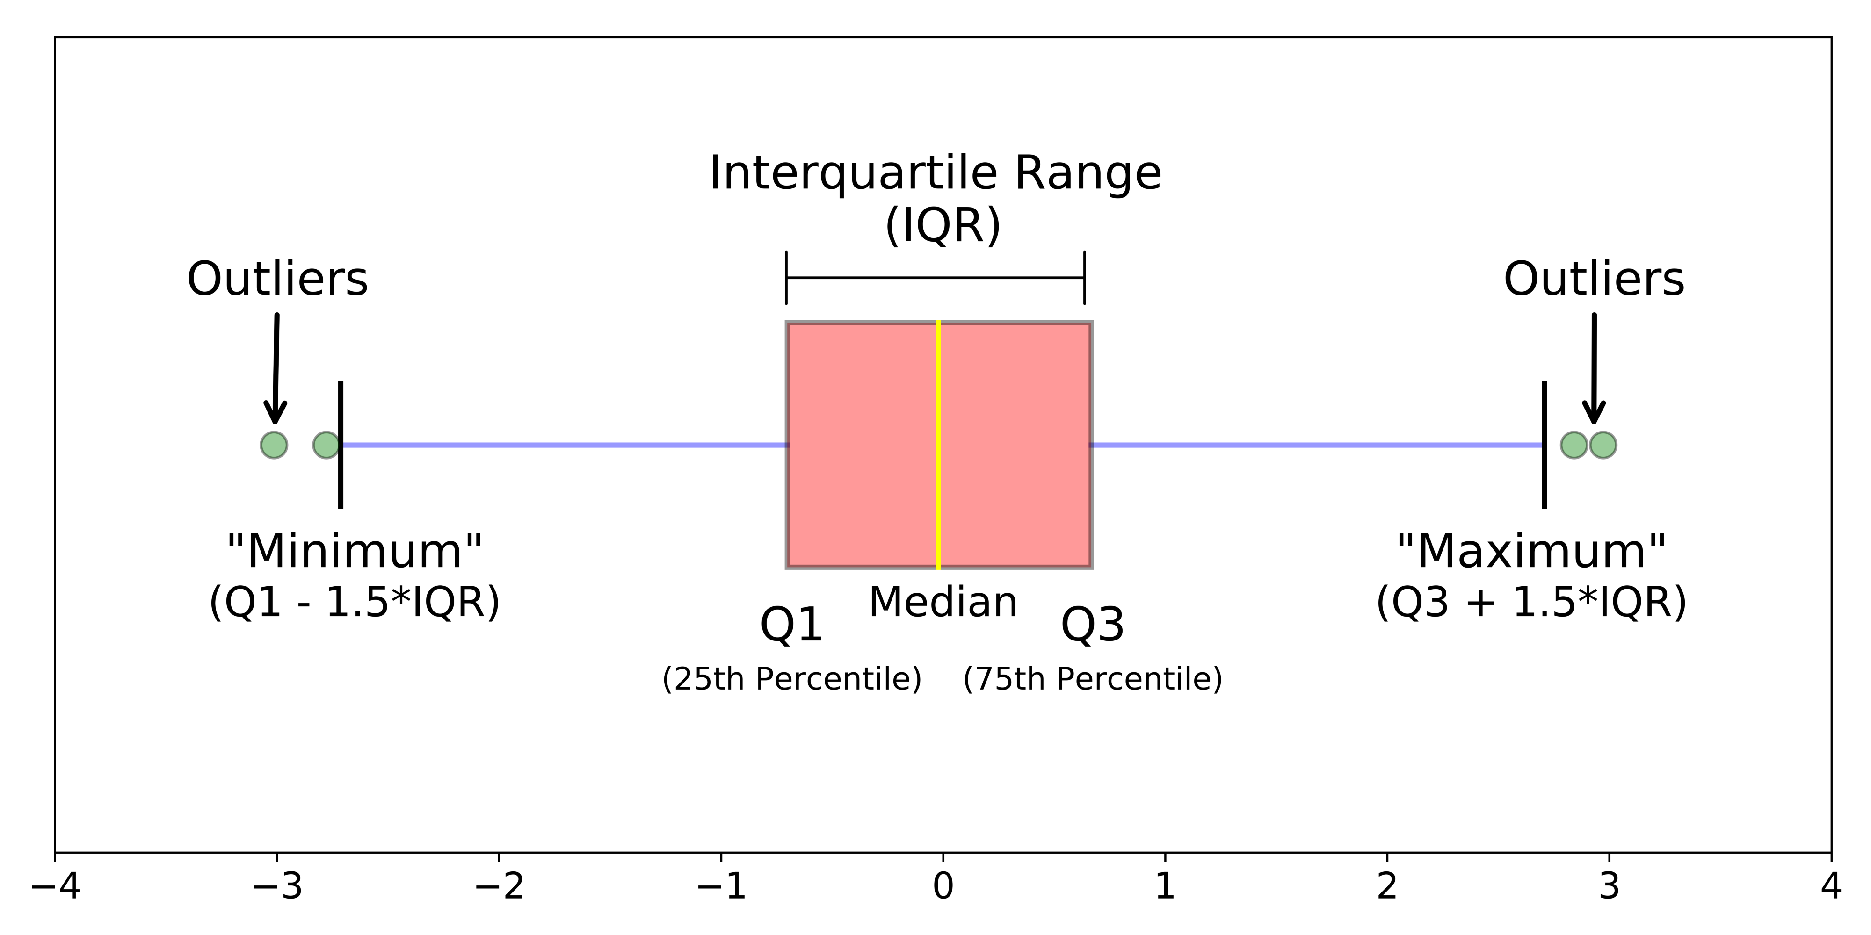
Basic plotting in R – Boxplots
boxplot(formula, data = NULL, …, subset, na.action = NULL, xlab , ylab, …)
An extremely useful way to present summary statistics
Minimum : the lowest data point excluding any outliers
Maximum : the largest data point excluding any outliers
Median (Q2 / 50th percentile) : the middle value of the dataset
First quartile (Q1 / 25th percentile) : also known as the lower quartile qn(0.25), is the median of the lower half of the dataset
Third quartile (Q3 / 75th percentile) : also known as the upper quartile qn(0.75), is the median of the upper half of the dataset
Interquartile range (IQR) : is the distance between the upper and lower quartiles [IQR = Q 3 − Q 1]

Slide 16
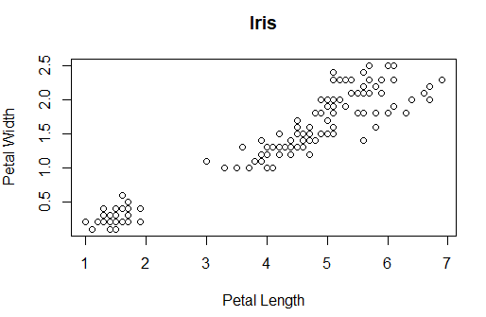
Basic plotting in R – Scatter plot
Displays of the relationship between two numerical variables
plot(x, y, …)

Slide 17
Basic plotting in R – plot() options
plot(x, y, …)
type : p (points) | l (lines) | b (both) | o (overplotted) | c (only the lines of b) | h (histogram-like vertical lines) | s (stair steps) | S (other steps) | n (no plotting)
main
sub : sub-title
xlab
ylab
asp : y/x aspect ratio (plot window)
Other graphical parameters

Slide 18
Graphical parameters
We can customize our graphs by changing various parameters either using the function par(option_name = option_value), or by passing those options as arguments in high level plotting functions (plot.default, plot.window, points, lines, abline, axis, title, text, mtext, segments, symbols, arrows, polygon, rect, box, contour, filled.contour and image)
col : color (also we have col.axis, col.main, col.lab, col.sub) – we can specify the colors we want to use by their name, their hex RGB code (#RRGGBB) or a color palette
font : font of text used (also font.main, font.sub, font.axis, font.lab)
lty : line type – a number (0=blank, 1=solid (default), 2=dashed, 3=dotted, 4=dotdash, 5=longdash, 6=twodash) or a character ("blank", "solid", "dashed", "dotted", "dotdash", "longdash", or "twodash")
lwf : line width (default:1)

Slide 19
Customizing a graph
We can modify:
Titles
Legends
Texts
Lines
Axes
Tick marks
Plotting symbols
Line types
The scope of these slides is merely an intro, so go ahead and check this amazing article out : http://www.sthda.com/english/wiki/graphical-parameters

Slide 20
Multiple plots
Using the par( ) :
par (mfrow = c(nrows, ncols)) -- creates a matrix with nrows and ncols and places a graph in each position, starting with the rows
par (mfcol = c(nrows, ncols)) -- creates a matrix with nrows and ncols and places a graph in each position, starting with the columns
Using the layout() function and passing a matrix that specifies the position of each graph, e.g.
layout(matrix(c(1,1,2,3), 2, 2, byrow = TRUE))
will create a 2x2 matrix, with 1 graph in the 1st row and 2 graphs in the 2nd row

Slide 21
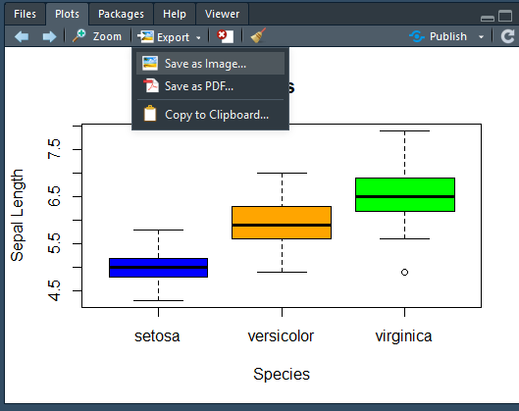
Saving plots
Using Rstudio
Create a file in the format you want -> create the graph -> close the device
Format | Example
JPG | jpeg(“file.jpg”) plot() dev.off()
PNG | png(“file.png”) plot() dev.off()
PDF | pdf(“file.pdf”) plot() dev.off()
…
https://www.stat.berkeley.edu/~s133/saving.html

Slide 23
Resources used
https://www.learnbyexample.org/r-scatter-plot-base-graph/
https://bookdown.org/mikemahoney218/LectureBook/
https://medium.com/@data_datum/r-for-newbies-explore-the-iris-dataset-with-r-16d1987f9edd
http://msudatascience.com/blog/2016/8/27/quick-analysis-in-r-with-the-iris-dataset
https://rpubs.com/moeransm/intro-iris
https://www.kaggle.com/antoniolopez/iris-data-visualization-with-r
https://warwick.ac.uk/fac/sci/moac/people/students/peter_cock/r/iris_plots/
https://towardsdatascience.com/dealing-with-apply-functions-in-r-ea99d3f49a71
https://www.r-graph-gallery.com/
https://www.rdocumentation.org/packages/graphics/versions/3.4.0/topics/plot
http://www.sthda.com/english/wiki/colors-in-r
https://www.statmethods.net/graphs/index.html
https://www.statmethods.net/advgraphs/index.html

